Slide 1


Slide 2

Diabetic Retinopathy Classification Using Deep Learning Techniques
Semester Fall 2022

Slide 3
Project code: ZN-CS-2025-146
Project Advisors: Dr. Hussam Ali (Internal)
Dr. Muhammad Fayyaz (External)
Project Manager: Prof. Dr. Muhammad Ilyas
Project Team: Zarnain Javed (Group Leader)
Roll no: BSCS51F22S022
Member 2: Narmeen Ayub
Roll no: BSCS51F22S011
Department of Computer Science and Artificial Intelligence
University Of Sargodha
Fall, 2022

Slide 4
Outline
Introduction
Literature Review
Research Challenges
Research Contributions
Research Questions
Proposed Methodology
Results and Discussions
Future Work
Bibliography

Slide 5
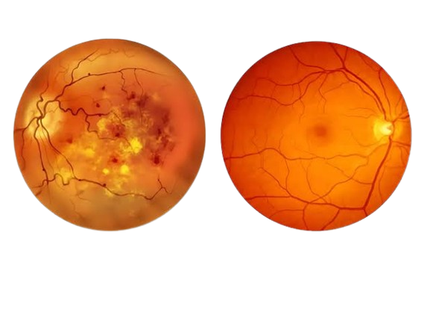
Introduction
Diabetic Retinopathy is one of the most serious complications of diabetes.
Its leading cause of blindness worldwide.
It develops when high blood sugar damages the small blood vessels in the retina.
Normal eye Diabetic Retina

Slide 6
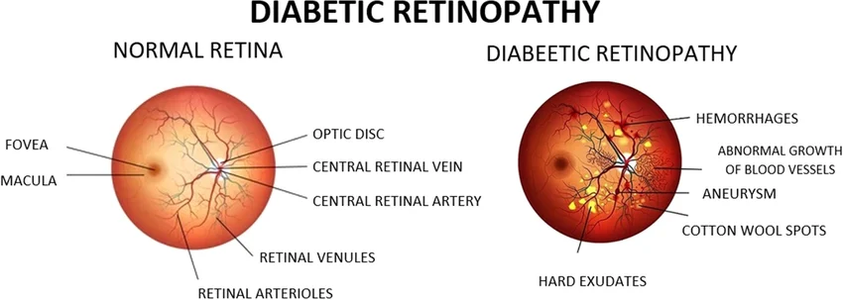
Introduction
Damaged blood vessels may leak fluid or blood .
If left untreated, DR can progress to cause vision loss.
Roughly, one-third of the 463 million people worldwide who have diabetes are affected by it [1].

Slide 7
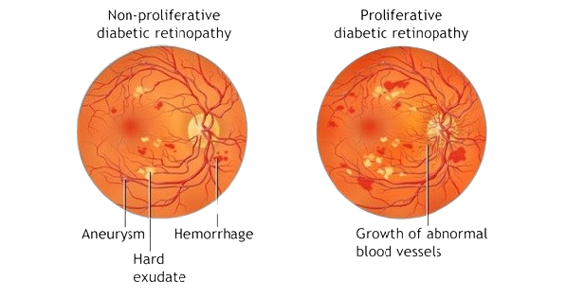
Introduction
The International Diabetes Federation (IDF) projects that there will be a significant increase in the global diabetes population from roughly 552 million in 2035 to 642 million in 2040 [2].
It has been seen that 25 % of all diabetics develop this complication after 10 years of developing Diabetes.
50 % develop it after 20 years of developing diabetes.

Slide 8
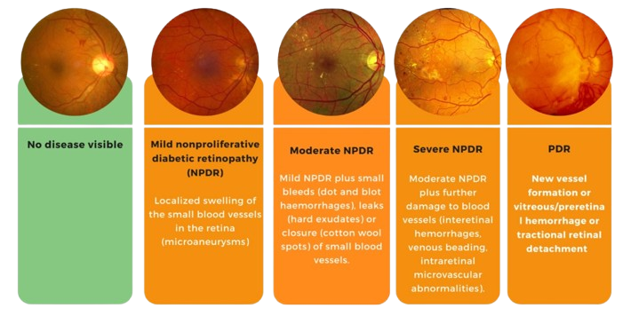
Stages of Diabetic Retinopathy

Slide 9
Problem Statement
Manual DR screening is difficult, time-consuming, and requires expert ophthalmologists. The growing number of patients makes large-scale screening challenging. Hence, an automated deep learning based system is required for efficient and reliable DR classification.
Why Deep Learning
Traditional machine learning:
Requires handcrafted features
Cannot capture complex lesion patterns
Deep Learning advantages:
Learns features automatically
Detects subtle lesions
Handles large image datasets
Provides end-to-end classification
CNNs have become the state-of-the-art for medical imaging.

Slide 10
Outline
Introduction
Literature Review
Research Challenges
Research Contributions
Research Questions
Proposed Methodology
Results and Discussions
Future Work
Bibliography

Slide 11
Literature Review of Traditional Approaches
Table 1: Traditional Approaches for Diabetic Retinopathy (2020-2025)
Ref | Year | Method/Approaches | Dataset | Acc (%)
[3] | 2015 | Image Enhancement, Manual Feature Extraction | Asian hospital datasets | 65–78%
[4] | 2016 | Screening Tools, Logistic Regression, Classical ML | Messidor, Duke, Clinical datasets | 70–80%
[5] | 2022 | 16-class SVM-based DR classification | DIARETDB1 | 77.3%

Slide 12
Literature Review of Deep Learning Approaches
Table 2: Deep Learning Approaches for Diabetic Retinopathy (2020-2025)
Ref | Year | Method/Approaches | Dataset | Acc (%)
[6] | 2025 | Retinopathy Severity Grading Network (RSG-NET) with extensive preprocessing and augmentation techniques. | Messidor-1 | 99.36%
[7] |  | Lightweight CNN + CLAHE + Augmentation + GAP | APTOS | 97.5%
[8] | 2024 | BV segmentation + CLAHE-TH enhancement, fused features into VGG19 / InceptionV3 classifier. | Kaggle DR detection dataset | 96%
[9] |  | Custom CNN with convolution, max-pooling, and dense layers using ReLU, compared against transfer learning models. | APTOS | 95.27%

Slide 13
Literature Review of Deep Learning Approaches
Table 2: Deep Learning Approaches for Diabetic Retinopathy (2020-2025)
Ref | Year | Method/Approaches | Dataset | Acc (%)
[10] | 2023 | Improved base CNN through hyperparameter tuning to create RetNet-10. | APTOS, Messidor2, and IDRiD (combined) | 98.65%
[11] |  | Teacher-student knowledge distillation using ResNet152V2 + Swin Transformer and Xception-CBAM | APTOS/IDRiD | 99.04%
[12] |  | CNN-based staging network predicting multiple DR severity levels | DR Dataset | 99.56%
[13] |  | Ensemble of deep CNN architectures with multi-scale feature extraction | APTOS | 79.50%
[14] | 2021 | Two-stage transfer learning method with PCA and Gradient Boosting for feature reduction and final classification. | E-ophtha(training), EyePACS, Messidor. | 99.73%

Slide 14
Literature Review of Hybrid Approaches
Table 3: Hybrid Approaches for Diabetic Retinopathy (2020-2025)
Ref | Year | Method/Approaches | Dataset | Acc (%)
[15] | 2026 | VR-FuseNet by combining VGG19 + ResNet50V2 / Hybrid Deep Learning approach | Aptos/Messidor-2/DDR/IDRID | 91.824%
[16] | 2025 | CNN+RNN(LSTM)/Feature fusion | DRIVE/EyePACS | 97.5%
[17] |  | CNN with dual attention modules (GAB + CAB) for enhanced feature extraction | APTOS /EyePACS | 83.20%
[18] |  | Transfer learning approach using NASNet-Large and ResNet-50 | APTOS | 91.14%
[19] |  | EffNet-SVM model by combining EfficientNetV2 small with SVM classifier | APTOS | 97.26%

Slide 15
Literature Review of Hybrid Approaches
Table 3: Hybrid Approaches for Diabetic Retinopathy (2020-2025)
Ref | Year | Method/Approaches | Dataset | Acc (%)
[20] | 2024 | Hybrid CNN (ResNet-16 + Google-Net) with APSO + ML Classifiers | EyePACS | 94%
[21] |  | Hybrid deep learning approach combining Self-Attention Network (SAN)+Vision Transformer (Vit) | Kaggle Diabetic Retinopathy Detection dataset | 99%
[22] | 2023 | Combines ResNet50 and InceptionV3 features, fuses them, and classifies DR | Kaggle DR dataset | 96.85%
[23] |  | Pre-trained CNN models + Error Correction Output Code (ECOC) ensemble with Adaptive Differential Evolution (ADE) tuning | APTOS, (EyePac + Messidor-2) | 82%

Slide 16
Literature Review of Hybrid Approaches
Table 3: Hybrid Approaches for Diabetic Retinopathy (2020-2025)
Ref | Year | Method/Approaches | Dataset | Acc (%)
[24] | 2022 | GoogleNet and ResNet-18 for features extraction with SVM Classifier | APTOS | 89.29%
[25] |  | CNN + two VGG networks (VGG16 + VGG19) | APTOS | 90.60%

Slide 17
Literature Review of Vision Transformer Approaches
Table 4: Vision Transformer Approaches for Diabetic Retinopathy (2020-2025)
Ref | Year | Method/Approaches | Dataset | Acc (%)
[26] | 2025 | CNN with Transformers for local and global feature extraction | APTOS | 94.28
[21] | 2024 | hybrid deep learning approach combining Self-Attention Network (SAN)+Vision Transformer (Vit) | Kaggle Diabetic Retinopathy Detection dataset | 99%
[27] |  | Hybrid model combining U-Net segmentation, pretrained CNN, and Vision Transformer (ViT) for lesion segmentation, feature extraction and grading | APTOS/IDRiD | 89.1%

Slide 18
Literature Review of Vision Transformer Approaches
Table 4: Vision Transformer Approaches for Diabetic Retinopathy (2020-2025)
Ref | Year | Method/Approaches | Dataset | Acc (%)
[28] | 2023 | Pretrain VGG19 with feature attention module for highlighting lesion regions | APTOS | 95.70%
[29] |  | Feature Extraction Block (FEB) with transformer and Grading Prediction Block (GPB) with residual attention | DDR/IDRiD | 91.54%

Slide 19
Outline
Introduction
Literature Review
Research Challenges
Research Contributions
Research Questions
Proposed Methodology
Results and Discussions
Future Work
Bibliography

Slide 20
Research Challenges
Several research challenges exist in DR classification such as:
Class Imbalance Uneven distribution of DR stages causes models to favor majority classes, reducing detection performance for severe DR cases.
Limited Dataset Diversity Lack of variation in datasets leads to overfitting and poor generalization on real clinical images.
Subtle Differences between DR Stages Adjacent DR stages show very similar lesion patterns, making accurate classification difficult.
Model Interpretability Deep learning models act as black boxes, limiting clinical trust due to lack of clear decision explanations.

Slide 21
Outline
Introduction
Literature Review
Research Challenges
Research Contributions
Research Questions
Proposed Methodology
Results and Discussions
Future Work
Bibliography

Slide 22
Research Contributions
The contributions are summarized below:
Developed a hybrid deep learning architecture with multi-stage attention block for DR classification using retinal fundus images.
Applied image preprocessing techniques such as normalization, enhancement, and data augmentation to improve image quality and handle class imbalance.
Integrated an attention mechanism to focus on important retinal regions, enhancing feature extraction and classification performance.
Evaluated the model using standard performance metrics, including accuracy, precision, recall, F1-score, and QWK.

Slide 23
Outline
Introduction
Literature Review
Research Challenges
Research Contributions
Research Questions
Proposed Methodology
Results and Discussions
Future Work
Bibliography

Slide 24
Research Questions
RQ1: Can a deep CNN model with attention mechanism outperform standard CNN models in accurately classifying different stages of diabetic retinopathy? [Answer in chap 4]
RQ2: How does the integration of attention mechanisms help deep learning models handle image quality variations, class imbalance, and improve generalization across diverse real-world DR datasets? [Answer in chap 4]

Slide 25
Outline
Introduction
Literature Review
Research Challenges
Research Contributions
Research Questions
Proposed Methodology
Results and Discussions
Future Work
Bibliography

Slide 26
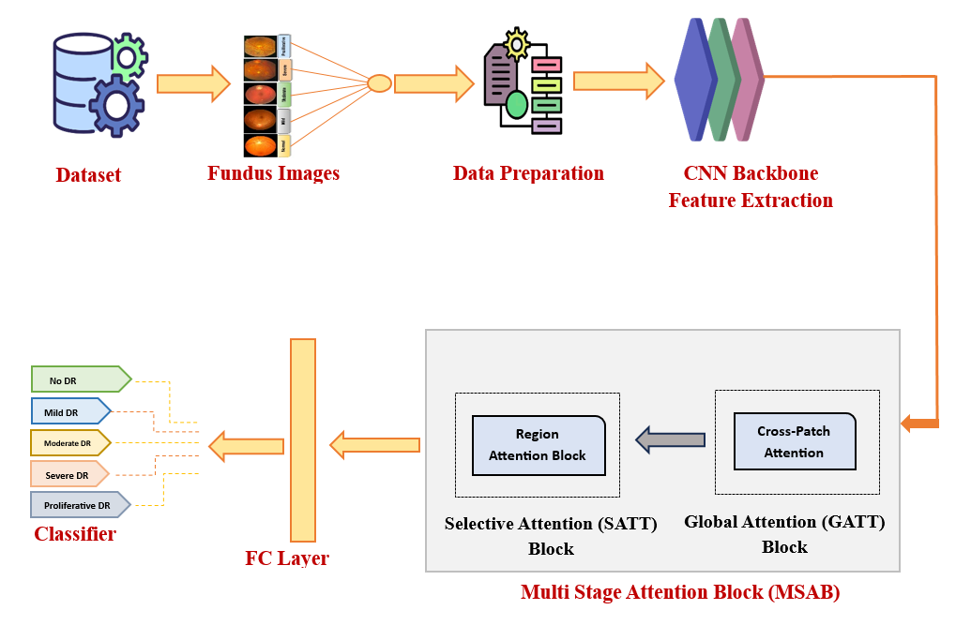
Figure 1: Workflow of Proposed Methodology

Slide 27
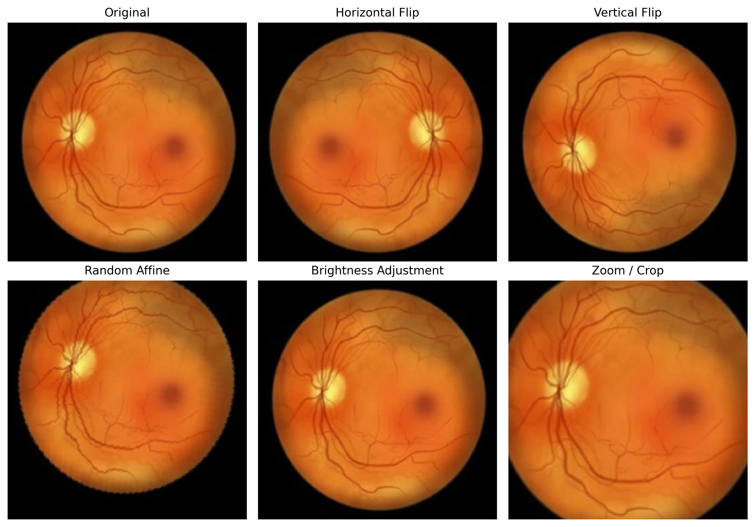
Proposed Methodology
This Proposed methodology consists of four steps such as data preparation, proposed hybrid DL architecture (CNN backbone feature extraction, multi-stage attention block, and fully connected layer) and classifier. The details related to these steps are given in the subsequent sections.
Data Preparation
1.1 Data Augmentation:
Techniques such as
vertical flip, horizontal flip, random affine
and brightness adjustment are applied
as shown in figure 2
Figure 2: Augmentation techniques

Slide 28
Proposed Methodology
1.2. Data Preprocessing
Preprocessing of input data is an essential step for image classification and recognition.
Initially each image is resized to a fixed resolution of 224 by 224 pixels with three color channels, allowing uniform input to the CNN architecture EfficientNet-B4. In addition, normalization was applied by scaling pixel values to a standard range, which helps stabilize the training process and improves convergence.

Slide 29
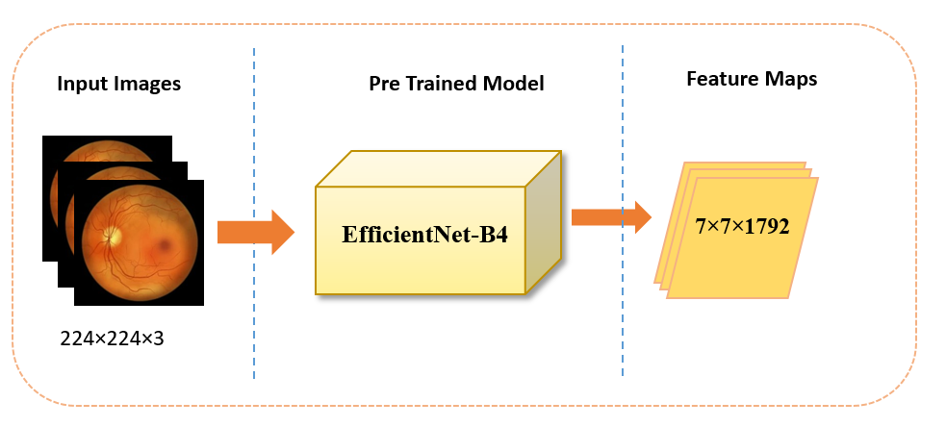
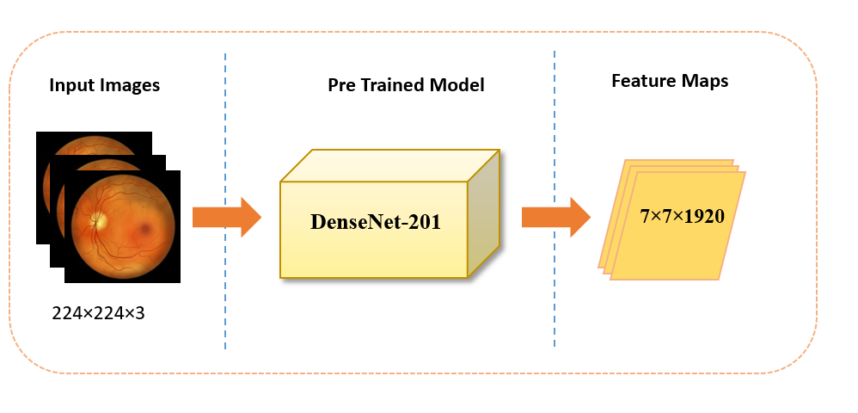
Proposed Methodology
2. Proposed Hybrid DL Architecture
2.1 CNN backbone:
EfficientNet-B4 and DenseNet-201 are selected for deep CNN feature extraction.
These takes input images of size 224 × 224 × 3 and produces high-dimensional feature maps of 7 × 7 × 1792 and 7 × 7 × 1920 that represent different levels of information within the image.
These feature maps contain both low-level features, such as edges, textures, and color variations, and high-level semantic information.
Figure 3: EfficientNet B4 as CNN backbone for feature extraction
Figure 4: DenseNet-201 as CNN backbone for feature extraction

Slide 30
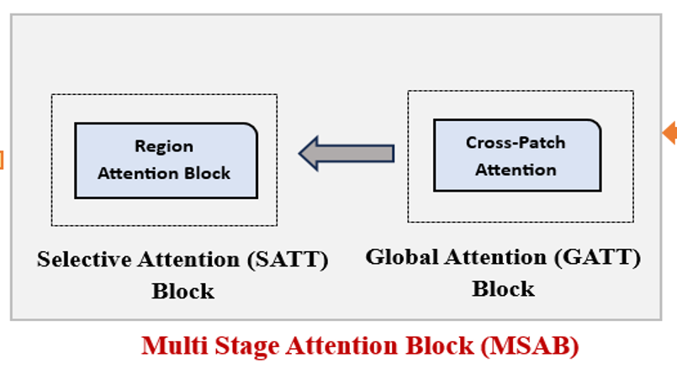
Proposed Methodology
2.2 Multi-Stage Attention Block (MSAB)
The Multi-Stage Attention Block (MSAB) serves as a key component of the proposed architecture, designed to enhance the discriminative ability of the features extracted by the EF-B4 backbone.
The MSAB is designed in two sequential stages,
Global Attention Block (GATT) and
Selective Attention Block (SATT) to capture
the similarity between patches and then focusing
on more clinically important regions
required for accurate classification of
DR stages together forming a dual-stage attention mechanism.
Figure 5 : Multi-Stage Attention Block (MSAB)

Slide 31
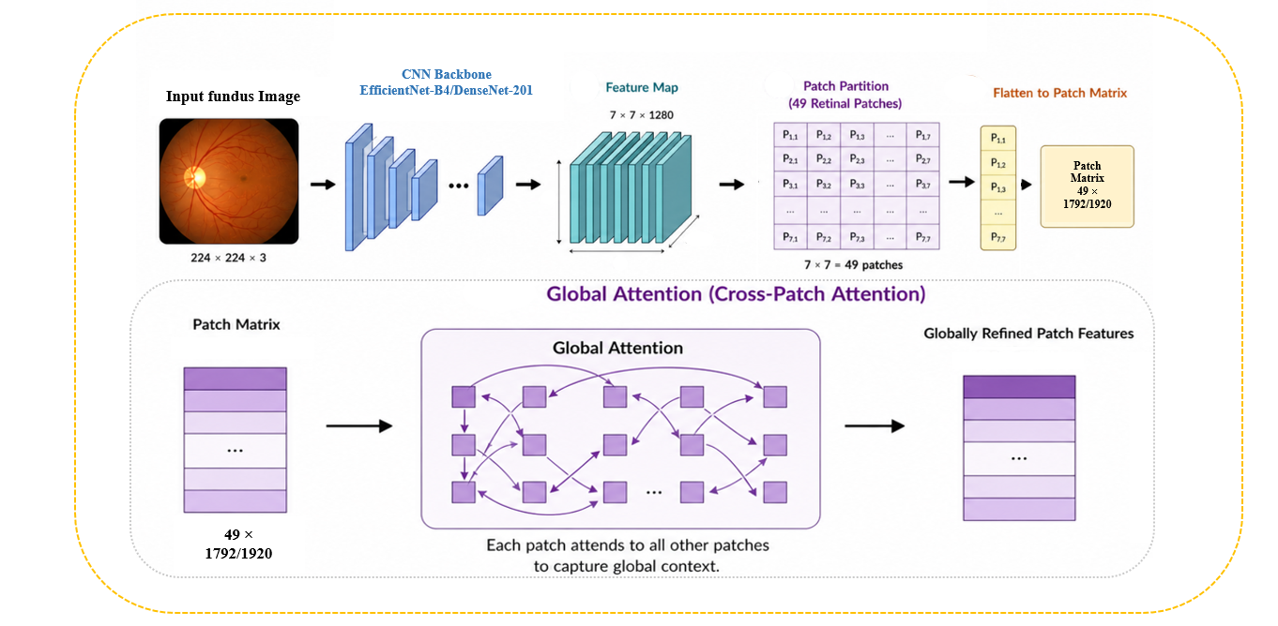
Proposed Methodology
2.2.1 Global Attention (GATT) Block
• The Global Attention block captures relationships between different regions of the retinal image. • It enables interaction among spatial patches of the feature map to learn global contextual information. • This helps the model understand lesion distribution across the entire retina rather than focusing only on local features. • As a result, feature representation becomes more informative, improving DR stage classification accuracy.
Figure 6: Global Attention (GATT) Block

Slide 32
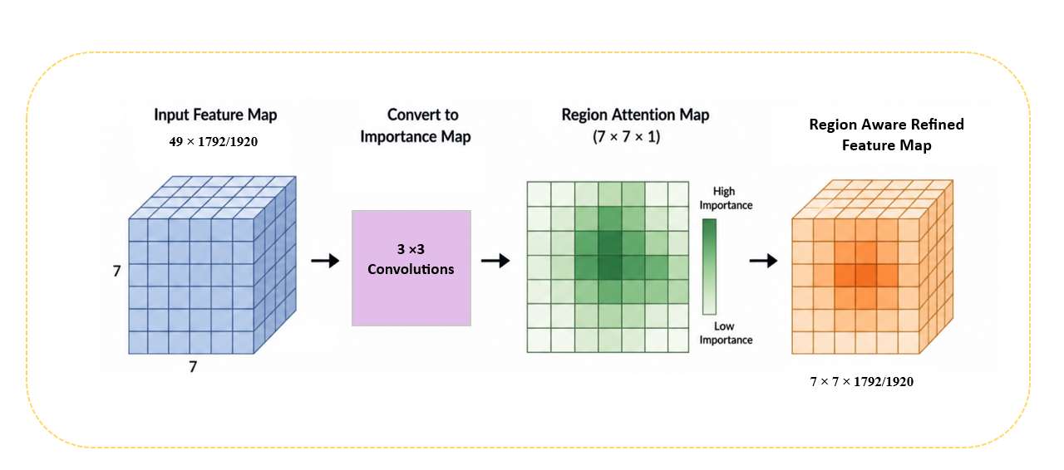
Proposed Methodology
2.2.2 Selective Attention (SATT) Block
• The Selective Attention block focuses on the most important feature channels related to diabetic retinopathy lesions. • It assigns higher weights to informative channels and suppresses less useful or noisy ones. • This channel-wise refinement enhances discriminative disease features. • As a result, the model produces more accurate and stable DR classification.
Figure 7: Region Attention (SATT) Block

Slide 33
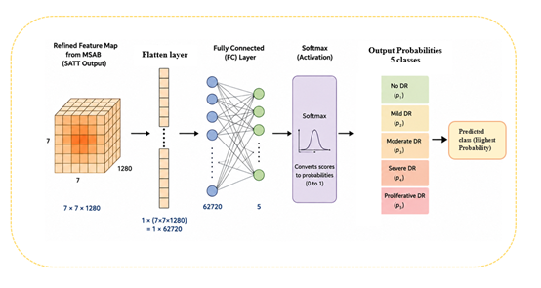
Proposed Methodology
2.3 Fully connected layers:
The Fully Connected (FC) layer converts refined feature maps into a compact feature vector for decision making. • It combines all learned global and regional features to form high-level representations. • The classifier then applies the Softmax function
to produce class probabilities for each DR stage. • The class with the highest probability
is selected as the final prediction.
2.4 Classifier:
The classifier predicts the diabetic retinopathy
stage. The output includes
No DR, Mild, Moderate, Severe, and
Proliferative DR.
Figure 8: Overall workflow illustrating final diabetic retinopathy prediction through flattening, fully connected layers, and Softmax classification.

Slide 34
Outline
Introduction
Literature Review
Research Challenges
Research Contributions
Research Questions
Proposed Methodology
Results and Discussions
Future Work
Bibliography

Slide 35
Results and Discussions
This section will present the experimental setup and results obtained after implementing proposed methodology for DR classification. The evaluation of each task is described separately in subsequent sections.
Datasets Used:
Table 5: Statistics of Applied Dataset
Datasets | Image type | No of images | Challenges
APTOS | Retinal Fundus Images | 3,662 images | Small dataset size, Imbalance classes, Lesion Similarity
IDRiD | Retinal Fundus Images | 1548 images | Class imbalance, low resolution, limited samples, uneven distribution

Slide 36
Results and Discussions
2. Data Oversampling
Oversampling is a data balancing technique used to address unequal class distribution in machine learning datasets [30]. It works by increasing the number of samples in minority classes so that all classes contribute equally during model training.
Table 6:Oversampling statistics for (APTOS, IDRiD) datasets
Description | Datasets | Classes
 |  | No DR | Mild | Moderate | Severe | Proliferative
Class-wise selected images | APTOS | 1805 | 370 | 999 | 193 | 295
Oversampled images |  | 0 | 1435 | 806 | 1612 | 1510
Original + Oversampled images |  | 1805 in each class
Class-wise selected images | IDRiD | 402 | 60 | 408 | 222 | 147
Oversampled images |  | 6 | 348 | 0 | 186 | 261
Original + Oversampled images |  | 408 in each class

Slide 37
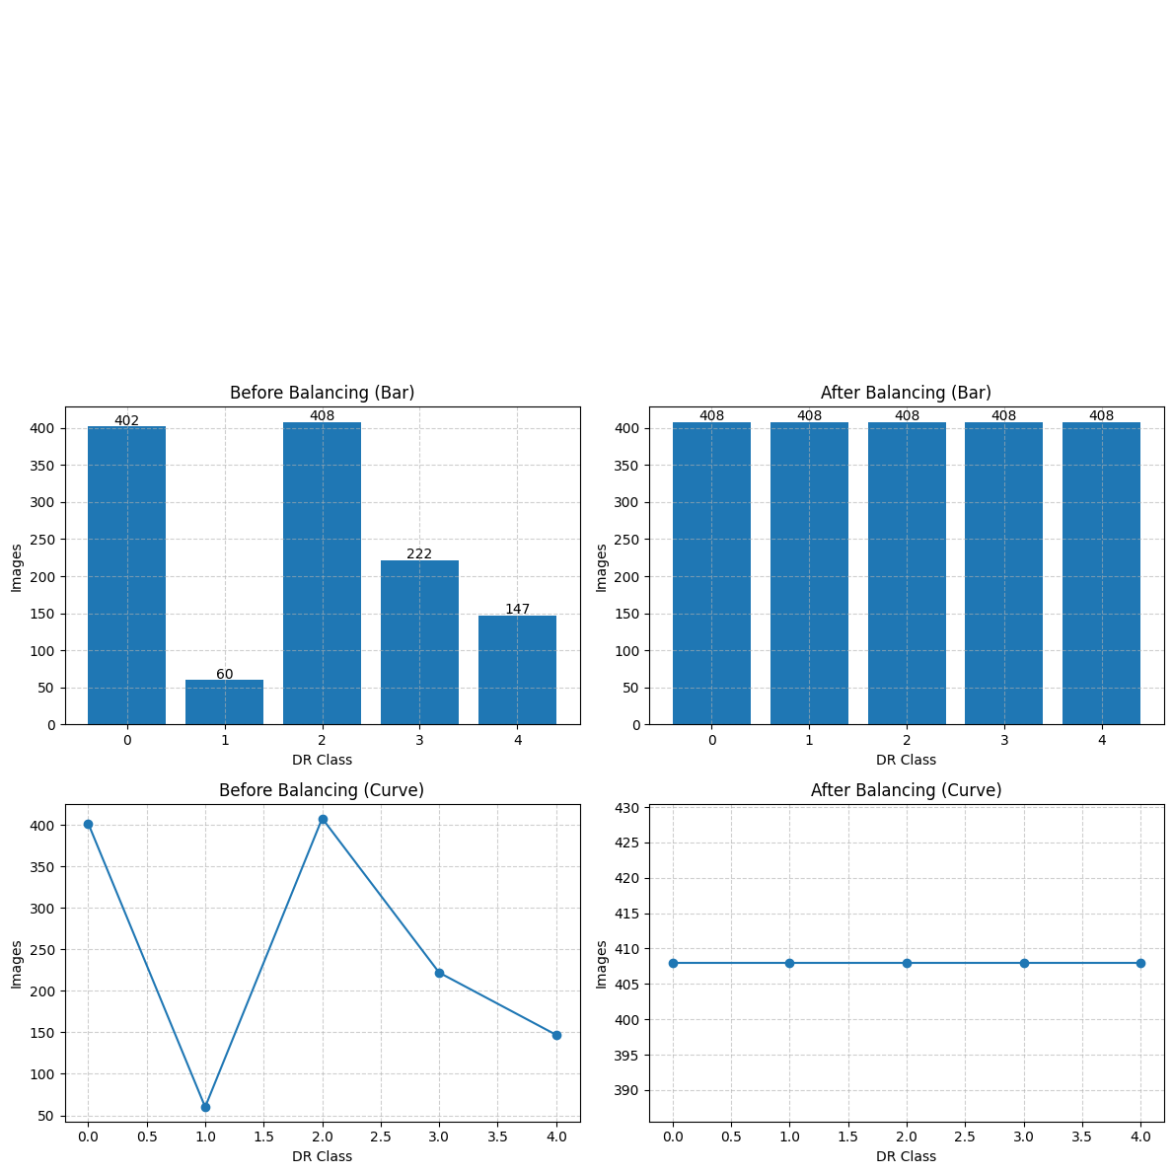
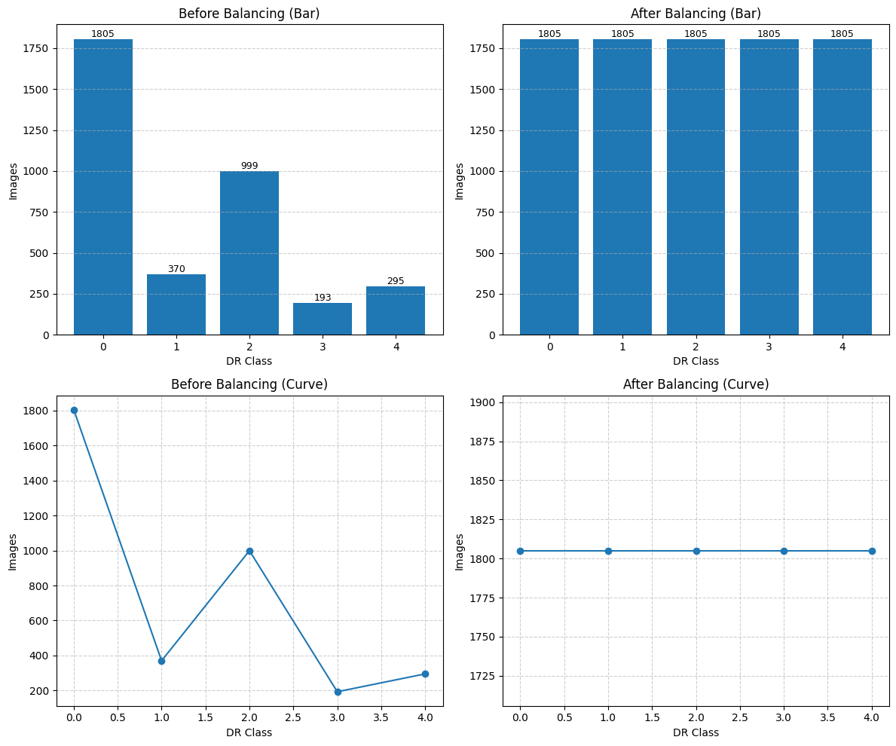
Results and Discussions
2. Data Oversampling
Figure 9: APTOS dataset before and after oversampling
Figure 10: IDRiD dataset before and after oversampling

Slide 38
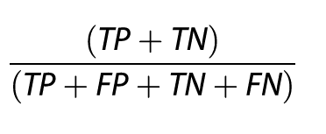
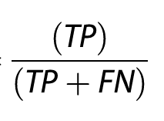
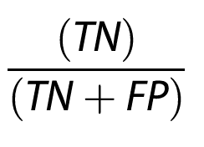
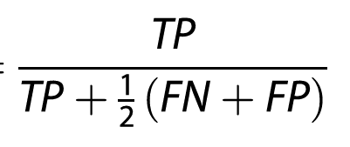
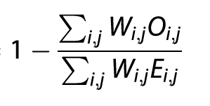
Results and Discussions
3. Evaluation Metrics
Table 7: Performance Classification Matrices
Matrics | Equations
Accuracy
Precision
Recall
F1-Score
Quadratic Weighted Kappa (QWK)

Slide 39
Results and Discussions
4. Experimental Setup
Table 8: Experimental Setup
Parameter | Setting | Parameter | Setting
Development Environment | Google Colab (GPU-enabled) | Optimizer | AdamW
Backbone Network | EfficientNet-B4 | Learning Rate | 1 ×10−4
Input Image Size | 224 ×224 | Batch Size | 16
Datasets Used | APTOS and IDRiD | Model Selection Metric | Quadratic Weighted Kappa (QWK)
Train/Validation/Test Split | 80% / 10% / 10% | Classification Task | Five-Class DR Classification
Data Augmentation | Horizontal Flip, Rotation | Class Balancing Method | Random Over-Sampling

Slide 40
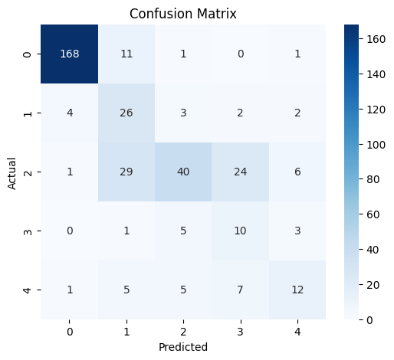
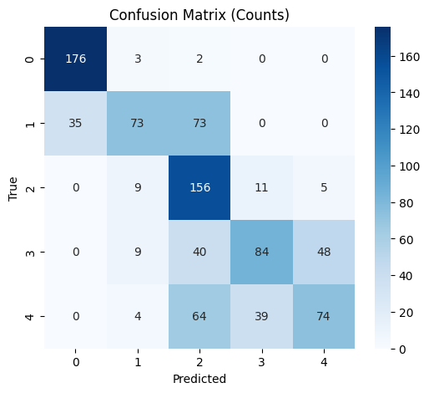
Results and Discussions
5. Confusion Matrix Analysis
Figure 11: Confusion Matrix for APTOS Imbalanced using EfficientNet-B4
Figure 12: Confusion Matrix for APTOS Balanced using EfficientNet-B4

Slide 41
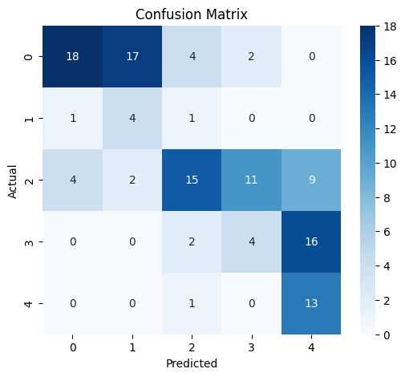
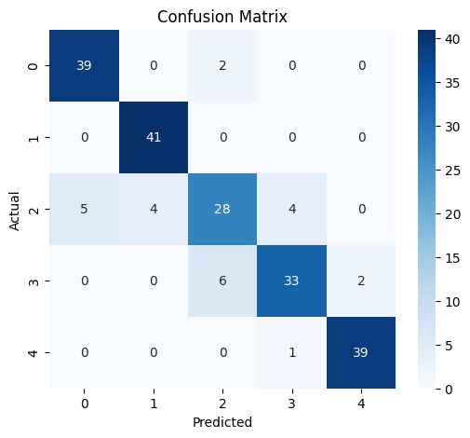
Results and Discussions
5. Confusion Matrix Analysis
Figure 13: Confusion Matrix for IDRiD Imbalanced using EfficientNet-B4
Figure 14: Confusion Matrix for IDRiD Balanced using EfficientNet-B4

Slide 42
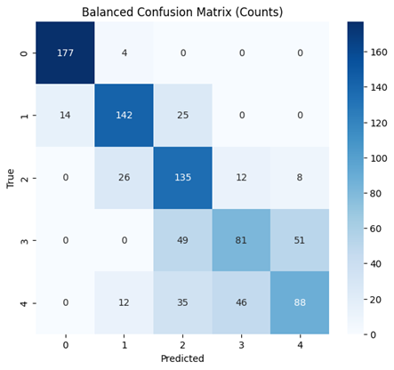
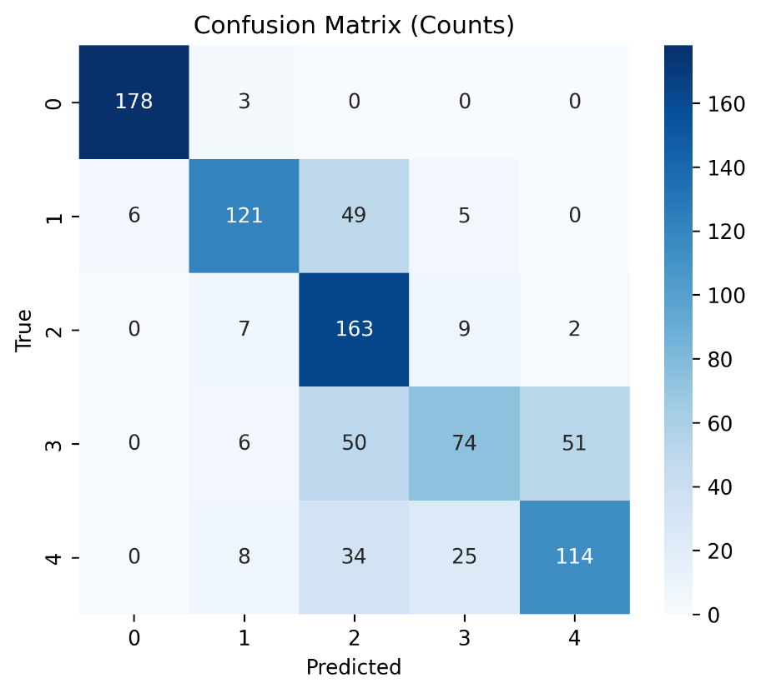
Results and Discussions
5. Confusion Matrix Analysis
Figure 15: Confusion Matrix for APTOS Imbalanced using DenseNet-121
Figure 16: Confusion Matrix for APTOS Balanced using DenseNet-121

Slide 43
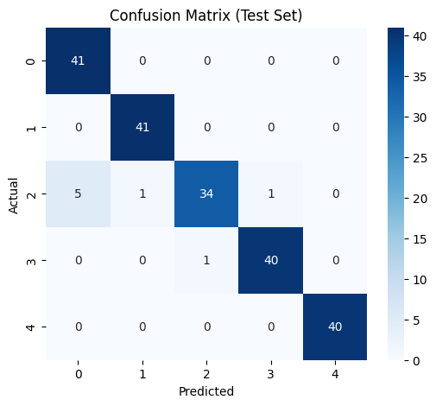
Results and Discussions
5. Confusion Matrix Analysis
Figure 17: Confusion Matrix for IDRiD Imbalanced using DenseNet-201
Figure 18: Confusion Matrix for IDRiD Balanced using DenseNet-201

Slide 44
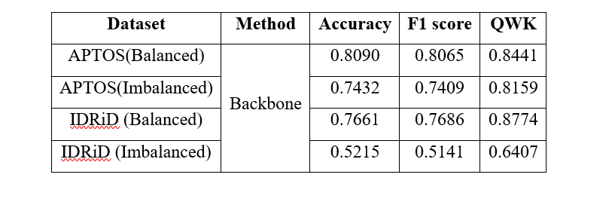
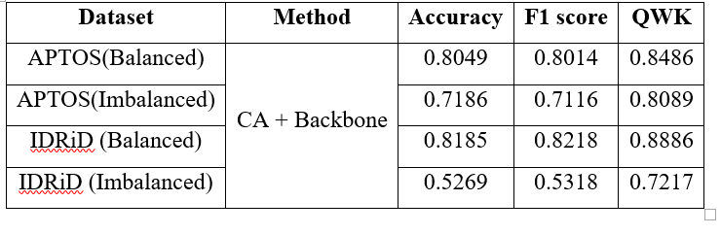
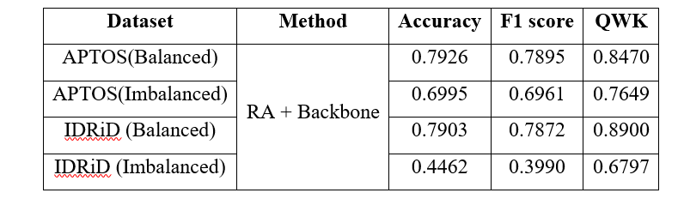
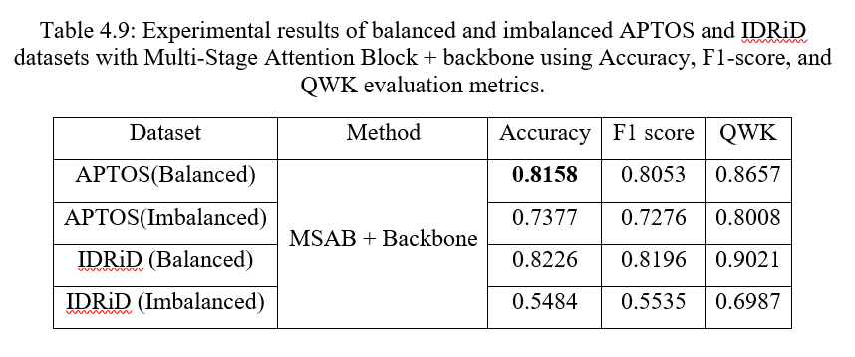
Results and Discussions
6. Ablation Study Using EfficientNet-B4 as Backbone
Table 9: Experimental results of balanced and imbalanced
APTOS and IDRiD datasets with EfficientNet B4 as backbone
using Accuracy, F1-score, and QWK evaluation metrics
Table 10: Experimental results of balanced and imbalanced
APTOS and IDRiD datasets with CA + backbone using Accuracy,
F1-score, and QWK evaluation metrics
Table 11: Experimental results of balanced and imbalanced
APTOS and IDRiD datasets with RA + backbone using Accuracy,
F1-score, and QWK evaluation metrics
Table 12: Experimental results of balanced and imbalanced
APTOS and IDRiD datasets with MSAB + backbone using Accuracy,
F1-score, and QWK evaluation metrics

Slide 45
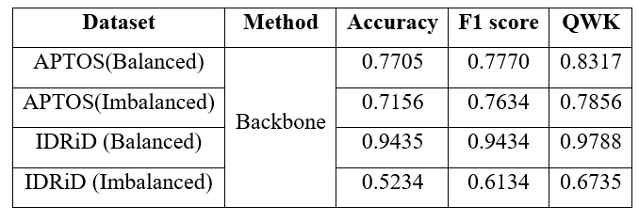
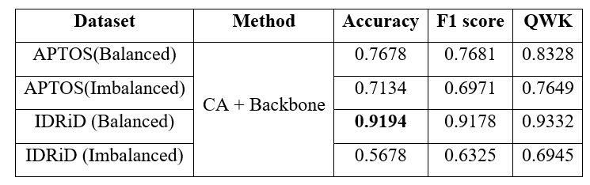
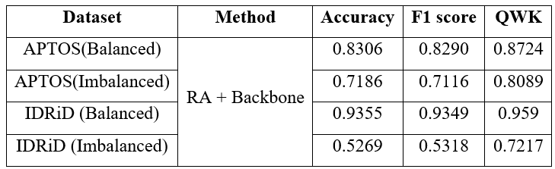
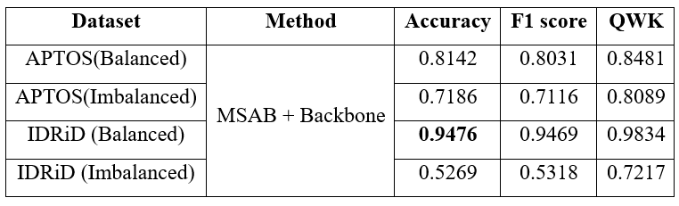
Results and Discussions
6. Ablation Study Using DenseNet-201 as Backbone
Table 13: Experimental results of balanced and imbalanced
APTOS and IDRiD datasets with DenseNet-201 backbone using
Accuracy, F1-score, and QWK evaluation metrics.
Table 14: Experimental results of balanced and imbalanced APTOS
and IDRiD datasets with DenseNet-201 backbone using Accuracy,
F1-score, and QWK evaluation metrics.
Table 15: Experimental results of balanced and imbalanced APTOS and IDRiD datasets with DenseNet-201 backbone using Accuracy, F1-score, and QWK evaluation metrics.
Table 16: Experimental results of balanced and imbalanced APTOS and IDRiD datasets with DenseNet-201 backbone using Accuracy, F1-score, and QWK evaluation metrics.

Slide 46
Results and Discussions
7. Comparison With Base Paper
Table 17: Comparison of proposed framework with Base-Paper
Reference | Architecture | Dataset | Accuracy | F1 | QWK
[17] | Multi-Stage attention Mechanism | APTOS | 80% | 79.0 | 0.87
Proposed | EffNet-B4+MSAB | APTOS | 81.58% | 80.53 | 86.57

Slide 47
8. Comparison With Existing Studies
Table 18: Comparison of proposed framework with Existing Studies
Reference | Year | Architecture | Dataset | Accuracy
[31] | 2022 | CNN | APTOS | 75.61%
[13] | 2023 | Hybrid |  | 79.50%
[17] | 2025 | Multi-attention Block |  | 80%
[32] | 2025 | Lesion Localization CNN |  | 77.80%
[15] | 2026 | VGG19 + ResNet50V2 / Hybrid approach | APTOS/IDRiD | 91.8%
[27] | 2024 | CNN, and Vision Transformer (ViT) |  | 89.1%
[29] | 2023 | Feature Extraction Block (FEB) with transformer |  | 91.54%
Proposed | EffNet-B4+MSAB |  | APTOS-Bal | 81.58%
 |  |  | APTOS-ImBal | 73.77%
 |  |  | IDRiD-Bal | 82.26%
 |  |  | IDRiD-ImBal | 54.84%
Proposed | DenseNet-201+MSAB |  | APTOS-Bal | 81.42%
 |  |  | APTOS-ImBal | 71.86%
 |  |  | IDRiD-Bal | 94.76%
 |  |  | IDRiD-ImBal | 52.69%

Slide 48
Results and Discussions
9. Discussions
The proposed EfficientNet-B4 with MSAB outperformed traditional CNN models in DR classification.
The attention mechanism improved lesion-focused feature learning and classification of different DR severity stages.
Strong performance was also achieved in Precision, Recall, F1-Score, and QWK. These results indicate the model’s ability to distinguish between different DR stages with reliable classification capability.
Traditional CNN-based approaches evaluated on the APTOS dataset achieved accuracies between 75.61% and 80%. In comparison, the proposed EfficientNet-B4 with Multi-Stage Attention Block (MSAB) achieved a higher accuracy of 81.58% on the balanced APTOS dataset and 82.26% on the balanced IDRiD dataset [Answer to RQ1].

Slide 49
Results and Discussions
9. Discussions
Attention mechanisms helped the model focus on important retinal lesions while suppressing irrelevant background information.
This improved robustness against image quality variations such as blur, noise, and illumination changes.
Finally, attention improves generalization across diverse datasets by capturing both local lesion details and global contextual relationships.
Although proposed model achieved higher accuracy under balanced conditions, while performance decreased on imbalanced datasets (73.77% on APTOS-ImBal and 54.84% on IDRiD-ImBal), the attention-guided model still performed better than conventional CNN approaches. [Answer to RQ2].

Slide 50
Outline
Introduction
Literature Review
Research Challenges
Research Contributions
Research Questions
Proposed Methodology
Results and Discussions
Future Work
Conclusion
Bibliography

Slide 51
Future Work
Use large retinal datasets to improve robustness and generalization of the proposed model.
Apply advanced data augmentation and synthetic data generation techniques to handle class imbalance and increase minority DR samples.
Use Different backbones for better feature extraction.
Incorporate Explainable AI techniques to provide visual decision support for clinicians and enhance trust in automated DR diagnosis.

Slide 52
Outline
Introduction
Literature Review
Research Challenges
Research Contributions
Research Questions
Proposed Methodology
Results and Discussions
Future Work
Conclusion
Bibliography

Slide 53
Conclusion
Proposed a hybrid deep learning framework for Diabetic Retinopathy (DR) classification using retinal fundus images
Integrated EfficientNet-B4 and DenseNet-201 as backbone with Multi-Stage Attention (MSAB) to enhance feature extraction and classification accuracy.
Applied preprocessing techniques to improve image quality and reduce the effect of class imbalance.
Introduced Cross-Patch Attention for global contextual learning and Region Attention for lesion-focused feature refinement.
Evaluated the framework on APTOS and IDRiD datasets under both balanced and imbalanced settings.
Achieved strong performance across evaluation metrics including Accuracy, Precision, Recall, F1-score, and QWK.
Ablation study validated the effectiveness of each attention module in improving DR stage discrimination.

Slide 54
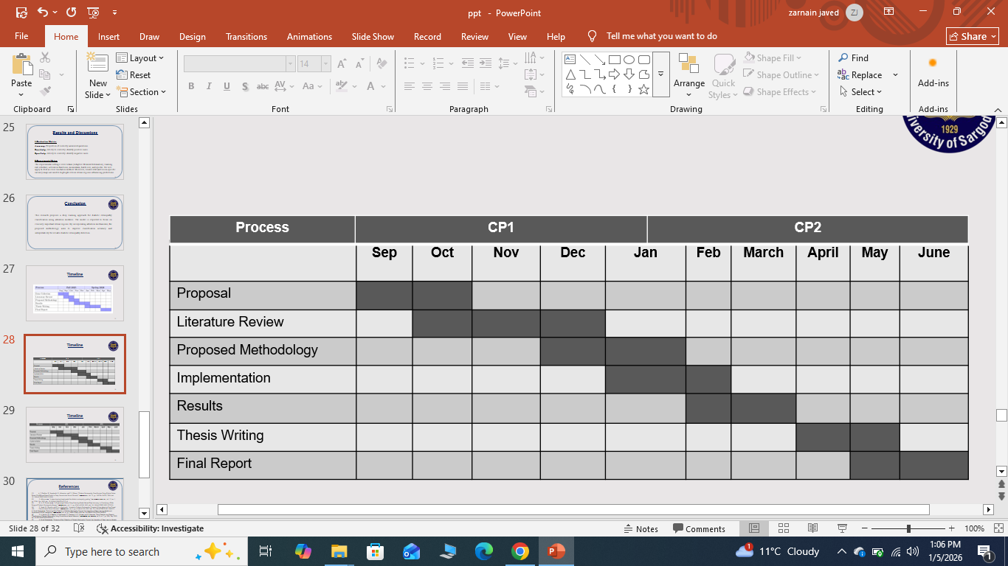
Timeline

Slide 55
References
W. L. Alyoubi, W. M. Shalash, and M. F. Abulkhair, “Diabetic retinopathy detection through deep learning techniques: A review,” Informatics Med. Unlocked, vol. 20, p. 100377, Jan. 2020, doi:10.1016/j.imu.2020.100377.
R. Rajalakshmi, R. Subashini, R. M. Anjana, and V. Mohan, “Automated diabetic retinopathy detection in smartphone-based fundus photography using artificial intelligence,” Eye (Lond)., vol. 32, no. 6, pp. 1138–1144, Jun. 2018, doi: 10.1038/S41433-018-0064-9.
Lee, R., T.Y. Wong, and C. Sabanayagam, Epidemiology of diabetic retinopathy, diabetic macular edema and related vision loss. Eye and vision, 2015. 2(1): p. 17.
Ting, D.S.W., G.C.M. Cheung, and T.Y. Wong, Diabetic retinopathy: global prevalence, major risk factors, screening practices and public health challenges: a review. Clinical & experimental ophthalmology, 2016. 44(4): p. 260-277.
Hardas, M., et al., Retinal fundus image classification for diabetic retinopathy using SVM predictions. Physical and Engineering Sciences in Medicine, 2022. 45(3): p. 781-791.
Akhtar, S., et al., A deep learning based model for diabetic retinopathy gr ading. Scientific reports, 2025. 15(1): p. 3763.
Karthik, S., et al., Early Detection and Severity Classification of Diabetic Retinopathy Using Convolutional Neural Networks. SN Computer Science, 2025. 6(7): p. 819.
Kadhim, A.J., et al., Diabetic retinopathy classification using hybrid color-based CLAHE and blood vessel in deep convolution neural network. IEEE Access, 2024. 12: p. 194750-194761.
Alavee, K.A., et al., Enhancing early detection of diabetic retinopathy through the integration of deep learning models and explainable artificial intelligence. IEEE Access, 2024. 12: p. 73950-73969.
Raiaan, M.A.K., et al., A lightweight robust deep learning model gained high accuracy in classifying a wide range of diabetic retinopathy images. IEEE Access, 2023. 11: p. 42361-42388.

Slide 56
References
Islam, N., et al., Toward lightweight diabetic retinopathy classification: A knowledge distillation approach for resource-constrained settings. Applied Sciences, 2023. 13(22): p. 12397.
Shamsan, A., E.M. Senan, and H.S. Ahmad Shatnawi, Predicting of diabetic retinopathy development stages of fundus images using deep learning based on combined features. Plos one, 2023. 18(10): p. e0289555.
Mohanty, C., et al., Using deep learning architectures for detection and classification of diabetic retinopathy. Sensors, 2023. 23(12): p. 5726.
Saeed, F., M. Hussain, and H.A. Aboalsamh, Automatic diabetic retinopathy diagnosis using adaptive fine-tuned convolutional neural network. IEEE Access, 2021. 9: p. 41344-41359.
Refat, S.R., et al., VR-FuseNet: A fusion of heterogeneous fundus data and explainable deep network for diabetic retinopathy classification. Biomedical Materials & Devices, 2026: p. 1-28.
Sushith, M., et al., A hybrid deep learning framework for early detection of diabetic retinopathy using retinal fundus images. Scientific Reports, 2025. 15(1): p. 15166.
Hannan, A., et al., Enhancing diabetic retinopathy classification accuracy through dual-attention mechanism in deep learning. Computer Methods in Biomechanics and Biomedical Engineering: Imaging & Visualization, 2025. 13(1): p. 2539079
Vallukappully, S., I. van der Linde, and A. Chakraborty, Early detection and classification of diabetic retinopathy by transfer learning of NASNet-large and ResNet-50 convolutional neural networks. Informatics in Medicine Unlocked, 2025: p. 101688.
Naveen, K., et al., Effnet-svm: A hybrid model for diabetic retinopathy classification using retinal fundus images. IEEE Access, 2025.
Jabbar, A., et al., A lesion-based diabetic retinopathy detection through hybrid deep learning model. IEEE access, 2024. 12: p. 40019-40036.
Shukla, A., S. Tiwari, and A. Jain, HybridFusionNet: Deep Learning for Multi-Stage Diabetic Retinopathy Detection. Technologies, 2024. 12(12): p. 256.

Slide 57
References
22. Ali, G., et al., A hybrid convolutional neural network model for automatic diabetic retinopathy classification from fundus images. IEEE Journal of Translational Engineering in Health and Medicine, 2023. 11: p. 341-350.
23. Wong, W.K., F.H. Juwono, and C. Apriono, Diabetic retinopathy detection and grading: A transfer learning approach using simultaneous parameter optimization and feature-weighted ECOC ensemble. IEEE Access, 2023. 11: p. 83004-83016.
24. Butt, M.M., et al., Diabetic retinopathy detection from fundus images of the eye using hybrid deep learning features. Diagnostics, 2022. 12(7): p. 1607.
25. Menaouer, B., et al., Diabetic retinopathy classification using hybrid deep learning approach. SN Computer Science, 2022. 3(5): p. 357.
26. Rezaee, K. and F. Farnami, Innovative approach for diabetic retinopathy severity classification: An ai-powered tool using CNN-transformer fusion. Journal of Biomedical Physics & Engineering, 2025. 15(2): p. 137.
27. Harisha, M., A. Bhosale, and M. Narender, Deep learning-powered segmentation and classification of diabetic retinopathy for enhanced diagnostic precision. Artificial Intelligence in Health, 2024. 1: p. 2783.
28. Ghosh, S. and A. Chatterjee, Introducing feature attention module on convolutional neural network for diabetic retinopathy detection. arXiv preprint arXiv:2308.02985, 2023.
29. Gu, Z., et al., Classification of diabetic retinopathy severity in fundus images using the vision transformer and residual attention. Computational Intelligence and Neuroscience, 2023. 2023(1): p. 1305583.
30. Mohammed, R., J. Rawashdeh, and M. Abdullah. Machine learning with oversampling and undersampling techniques: overview study and experimental results. in 2020 11th international conference on information and communication systems (ICICS). 2020. IEEE.
31. Raja Sarobin M, V. and R. Panjanathan, Diabetic retinopathy classification using CNN and hybrid deep convolutional neural networks. Symmetry, 2022. 14(9): p. 1932.
32. Gong, W., et al., Deep learning for enhanced prediction of diabetic retinopathy: A comparative study on the diabetes complications data set. Frontiers in Medicine, 2025. 12: p. 1591832.

